Slide 1
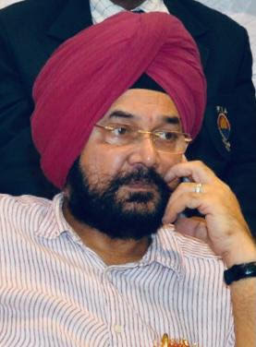
One week Online Short Term Course in Disaster Management & Environmental Awareness
Organized by
UGC Human Resource Development Centre,
Guru Nanak Dev University, Amritsar, Punjab, India
Date : 16 -09-2022 to 22-09-2022 Venue : Online Mode
Course is being organized under the dynamic leadership of the Chief Patron
Prof. (Dr.) Jaspal Singh Sandhu
Vice-Chancellor, GNDU, Amritsar, Punjab
About HRDC:
The Human Resource Development Centre (previously known as Academic Staff College), Guru Nanak Dev University, Amritsar was established in 1987 following introduction of the scheme by the University Grants Commission in 1987. Since its inception, it has been attracting teachers from all over India. UGC-HRDC is a platform where the Guru Nanak Dev University's academic community shares its knowledge, insights and ideas with the larger academic community of the country on a reciprocal basis.
Prof. (Dr.) Sudha Jitender, Director, UGC-HRDC, GNDU, Amritsar
Dr. Rajbir Bhatti, Deputy-Director, UGC-HRDC, GNDU, Amritsar
Course Coordinator:
Prof. (Dr.) Jatinder Kaur
Department of Botanical & Environmental Sciences
Guru Nanak Dev University Amritsar
Who can apply: Faculty Members of Universities/Colleges/Institutes of Higher Education of all Disciplines.
Register Online at: http://www.hrdcgndu.org/
For Queries please contact at: Ph. No. 8146482700, 9914336947 (9:00 AM to 5:00 PM) Working days only; Email - hrdc@gndu.ac.in

